Slide 1
Dynamic Barycenter Averaging Kernel in RBF Networks for Time Series Classification
作者: KEJIAN SHI, HONGYANG QIN, CHIJUN SIMA, SEN LI, LIFENG SHEN, QIANLI MA
期刊: IEEE ACCESS
Impact factor: 3.745
報告人: 藍語庭

Slide 2
Introduction

Slide 3
Dynamic Barycenter Averaging Kernel Radial basis function
First, we combine k-means clustering with a dynamic time warping (DTW) based averaging algorithm called DTW barycenter averaging (DBA) to determine the center of DBAK.
Then, in order to facilitate the stable gradient-training process in the whole network, a normalization term is added into the kernel formulation.
By integrating the information of the whole time warping path, our DBAK based RBF network (DBAK-RBF) performs efficiently for TSC tasks.

Slide 4
Method

Slide 5
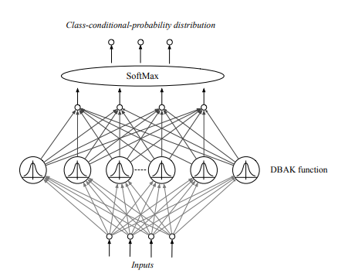
The general structure of RBF Network with DBAK

Slide 6
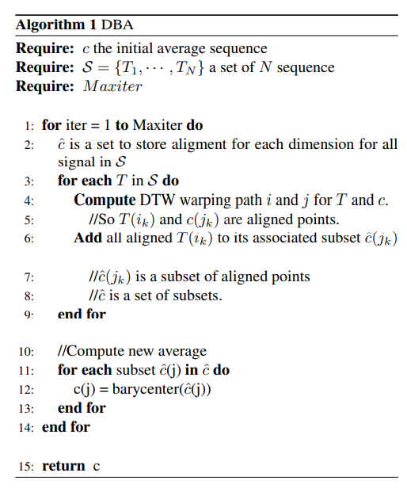
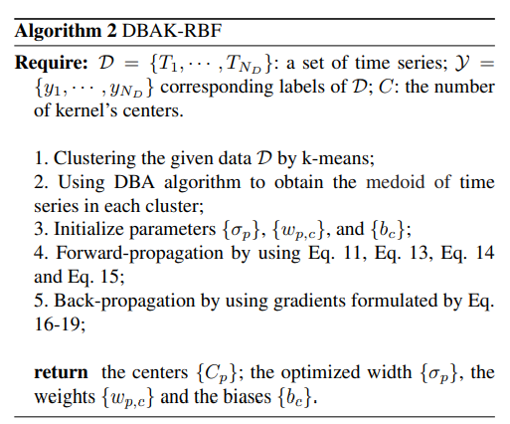
Algorithm

Slide 7
Result

Slide 8
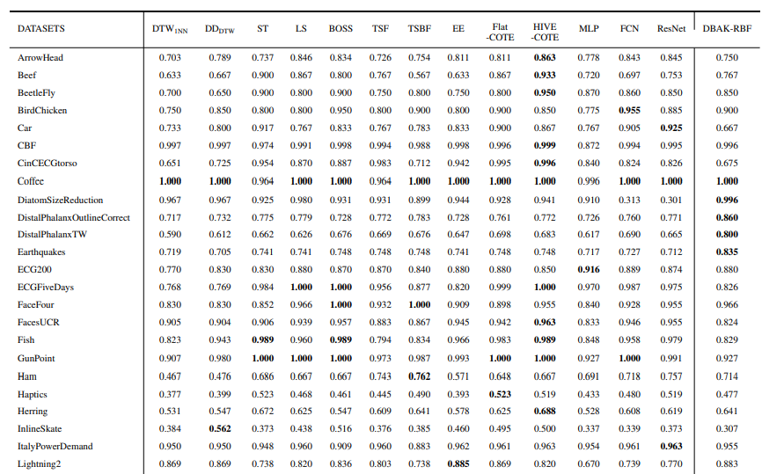
Accuracy of 13 mainstream TSC classifiers and our DBAK-RBF

Slide 9
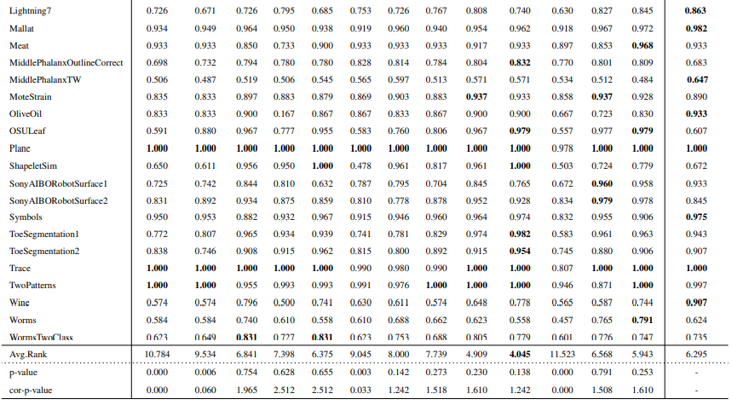
Accuracy of 13 mainstream TSC classifiers and our DBAK-RBF

Slide 10
Conclusion

Slide 11
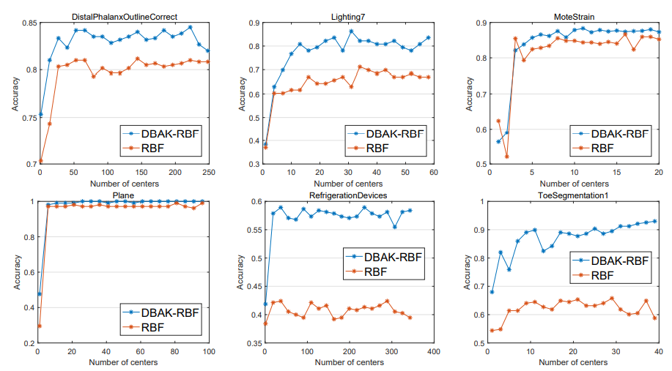
The performance of DBAK-RBF and RBF with different number of centers

